Slide 1

2025 Mid-Year Meeting
“What’s your Why?”

Slide 2

“What’s your Why?”

Slide 3

“What’s your Why?”

Slide 4

“What’s your Why?”

Slide 5
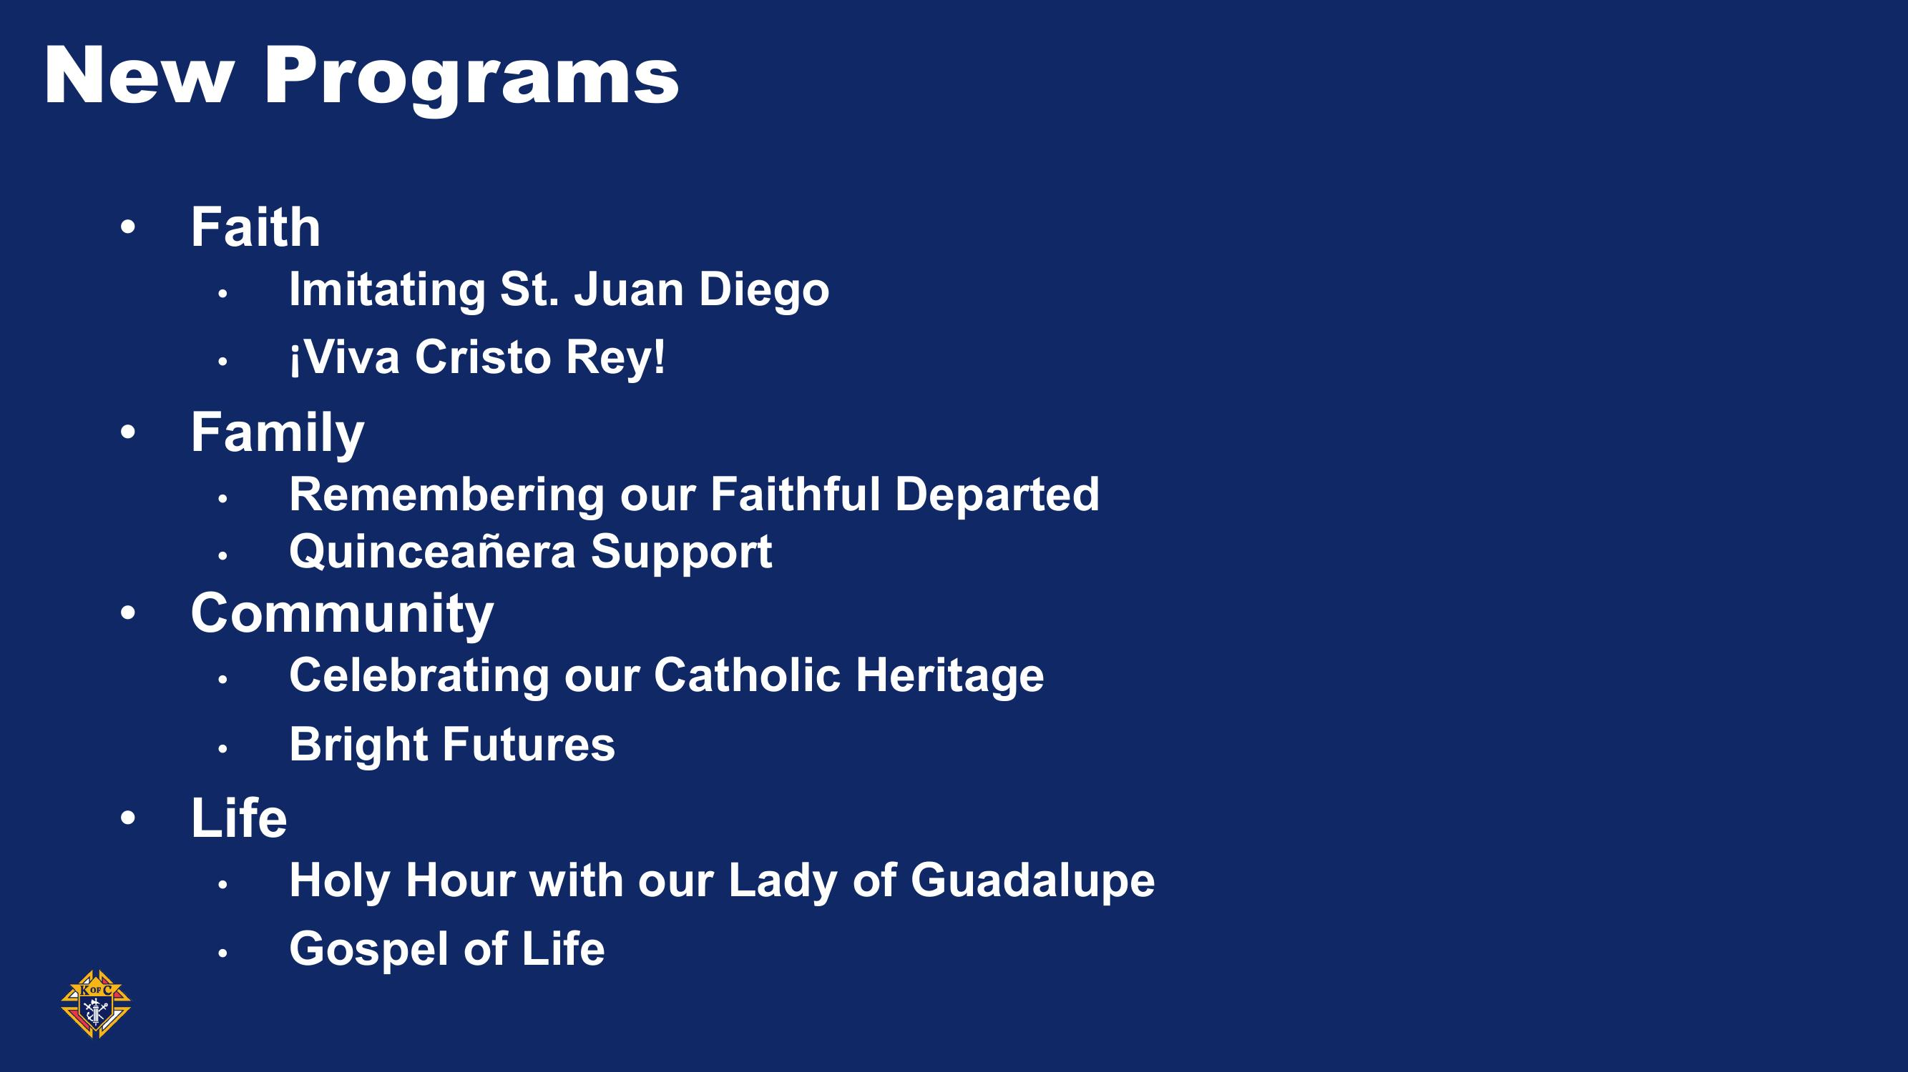
“What’s your Why?”

Slide 6
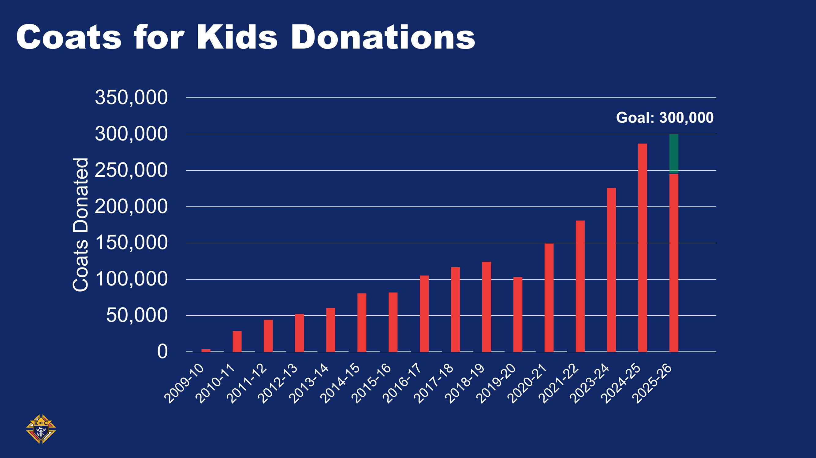
“What’s your Why?”

Slide 7
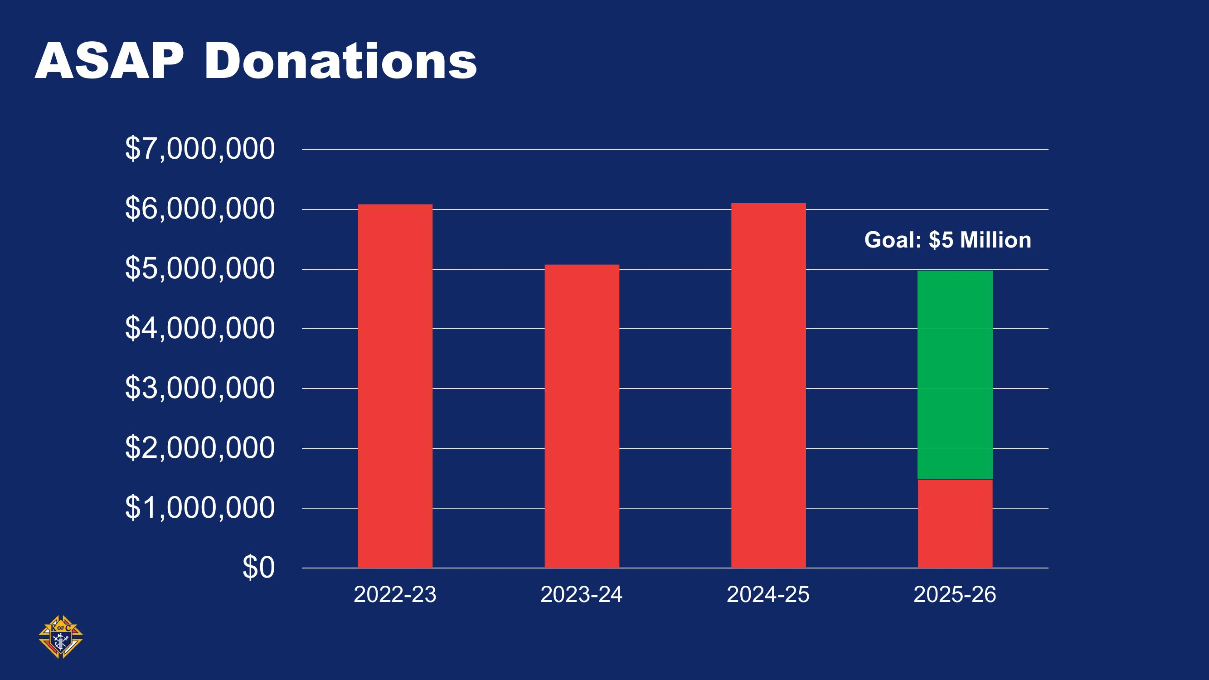
“What’s your Why?”

Slide 8
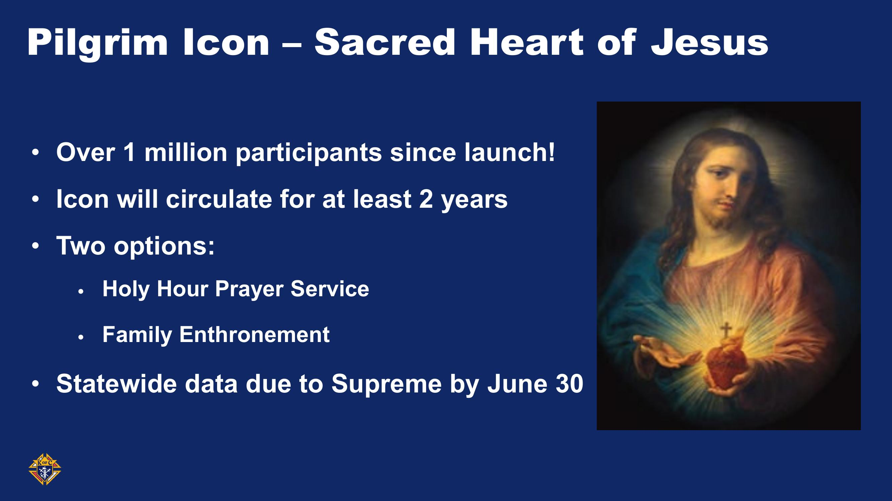
“What’s your Why?”

Slide 9
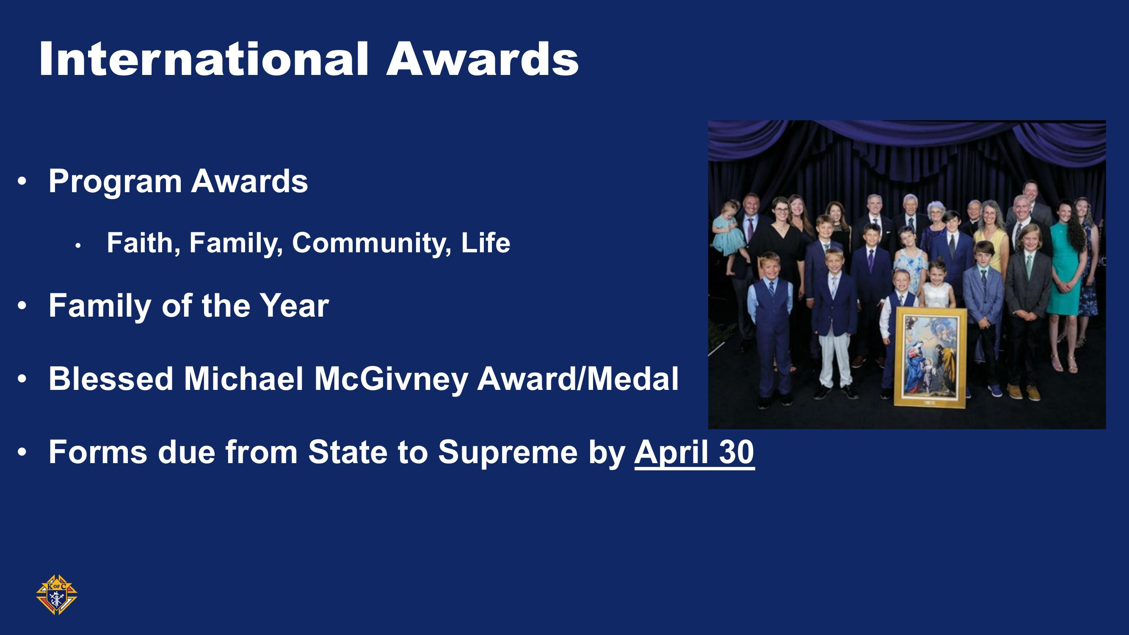
“What’s your Why?”

Slide 10
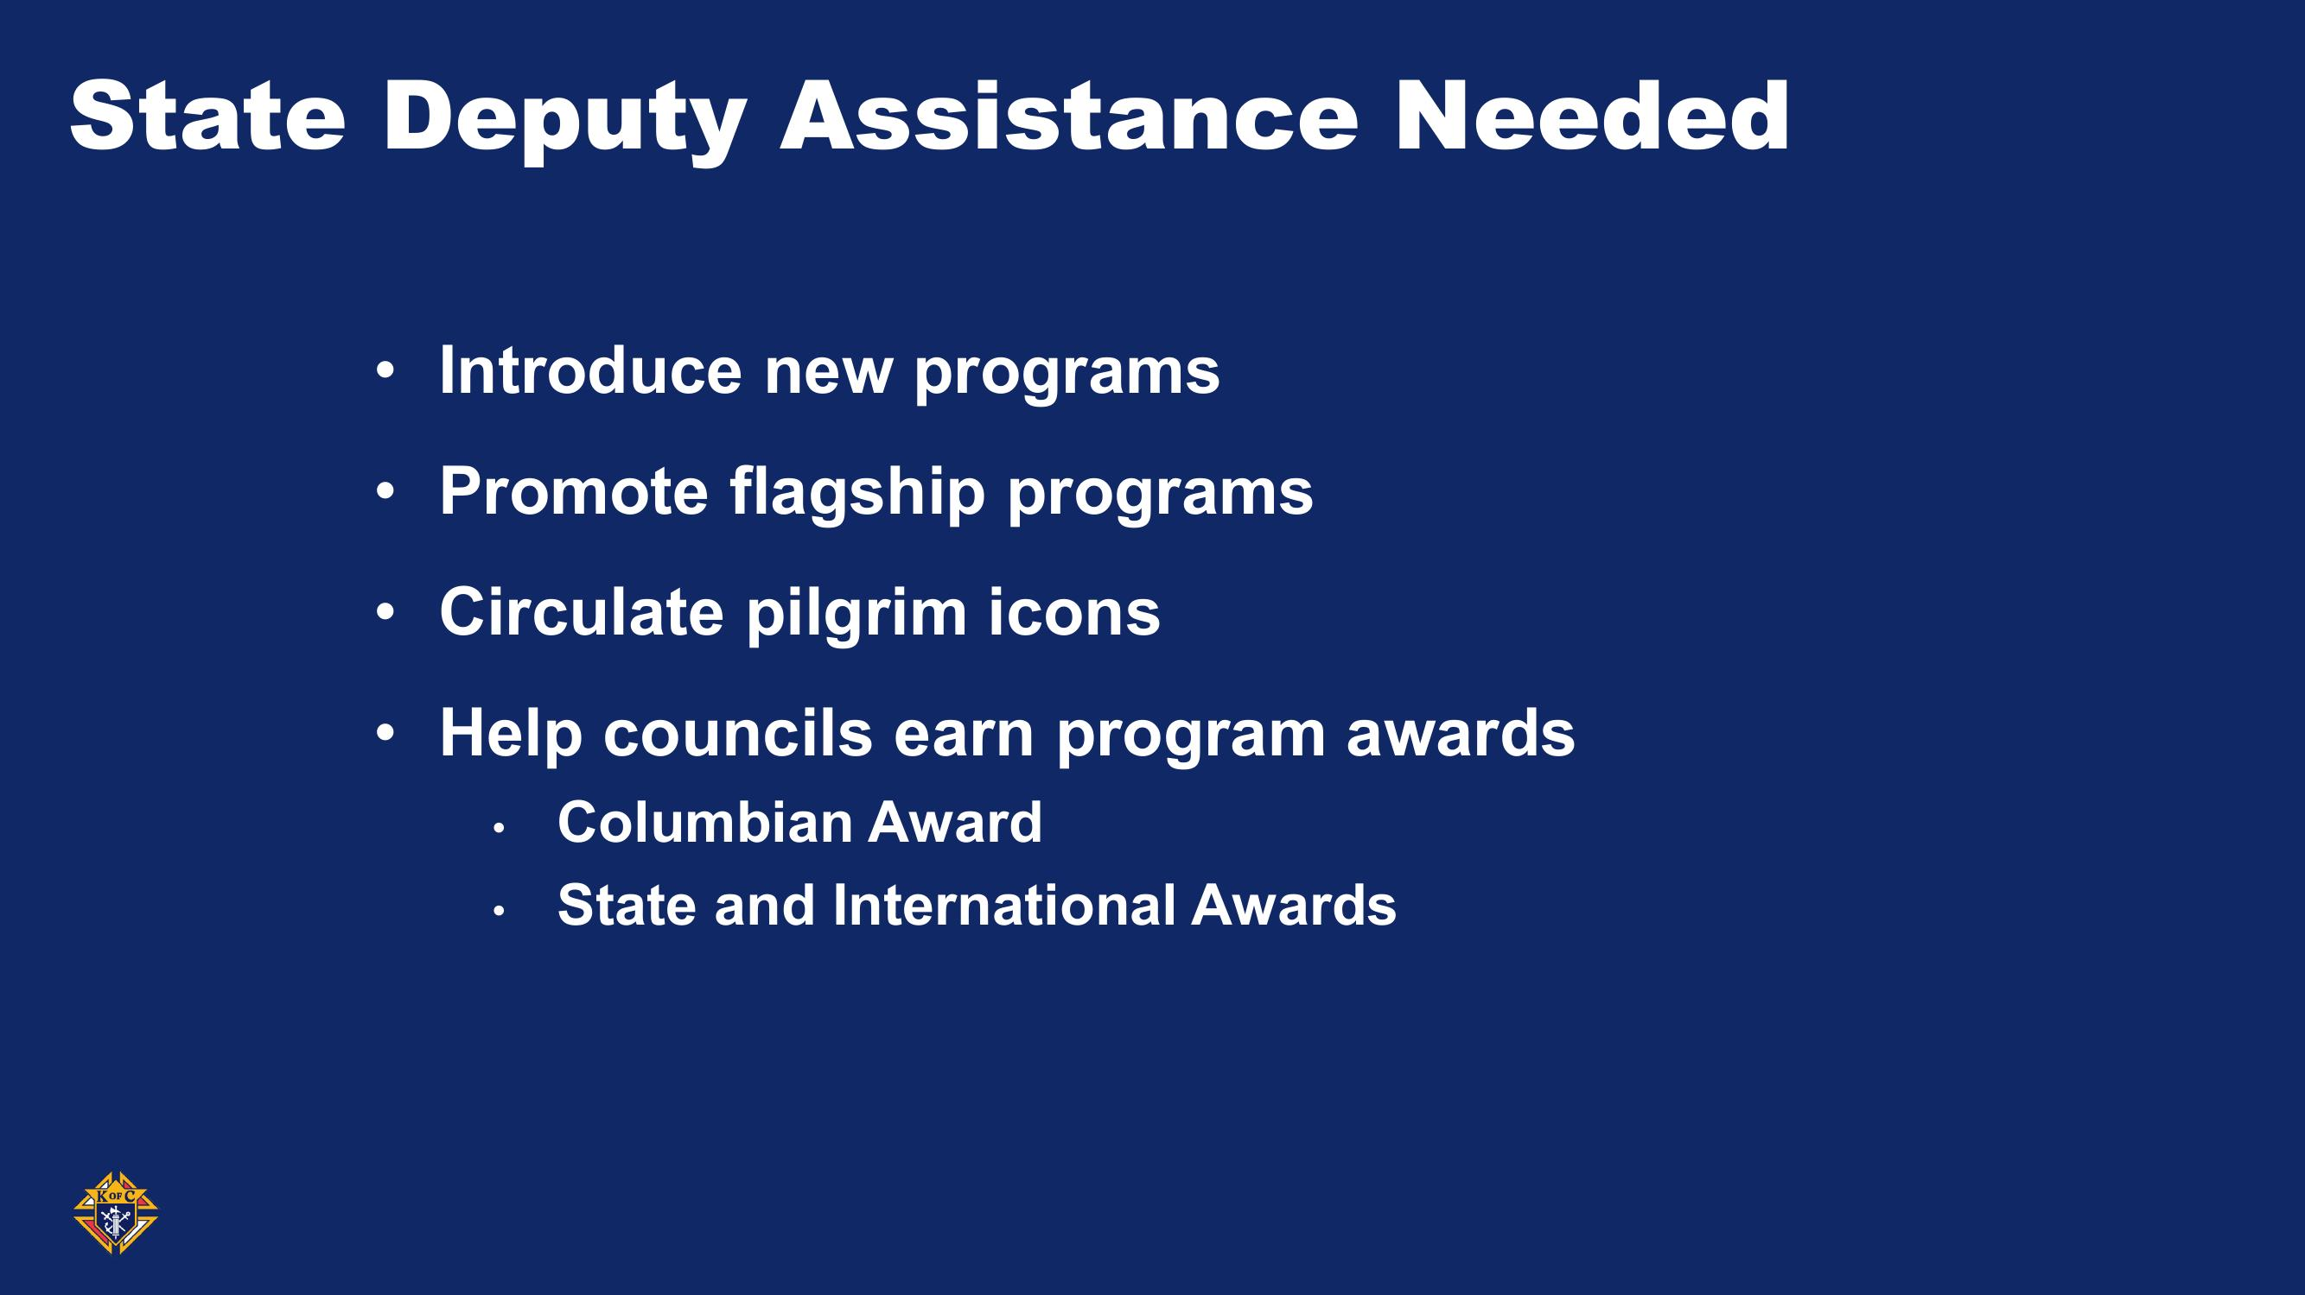
“What’s your Why?”

Slide 11

“What’s your Why?”

Slide 12
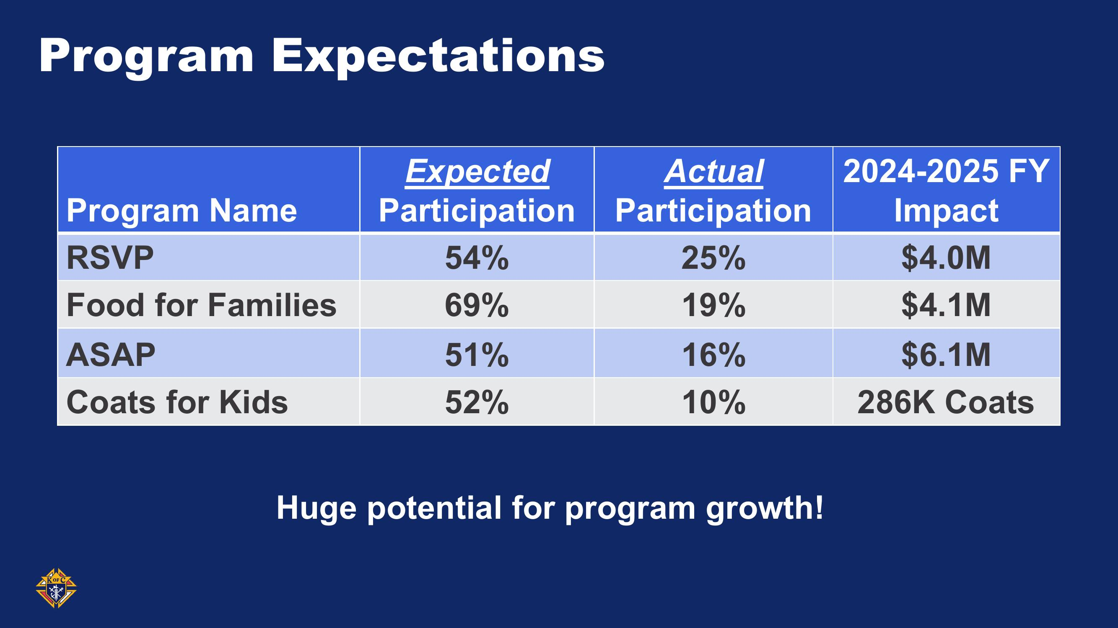
“What’s your Why?”

Slide 13
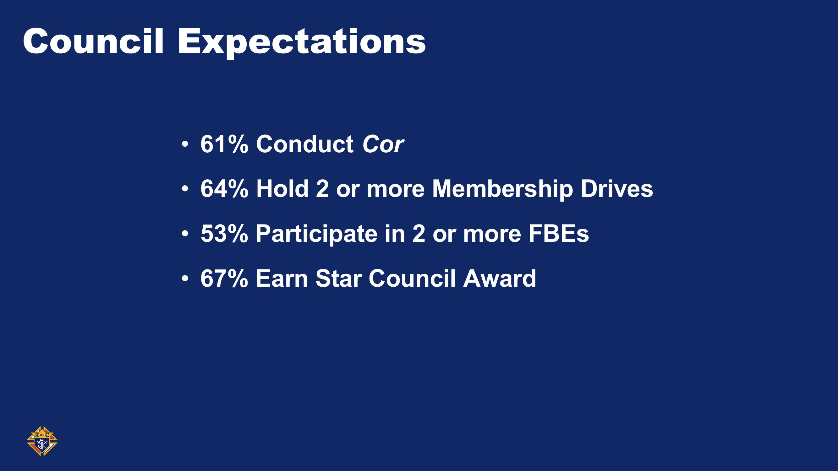
“What’s your Why?”

Slide 14
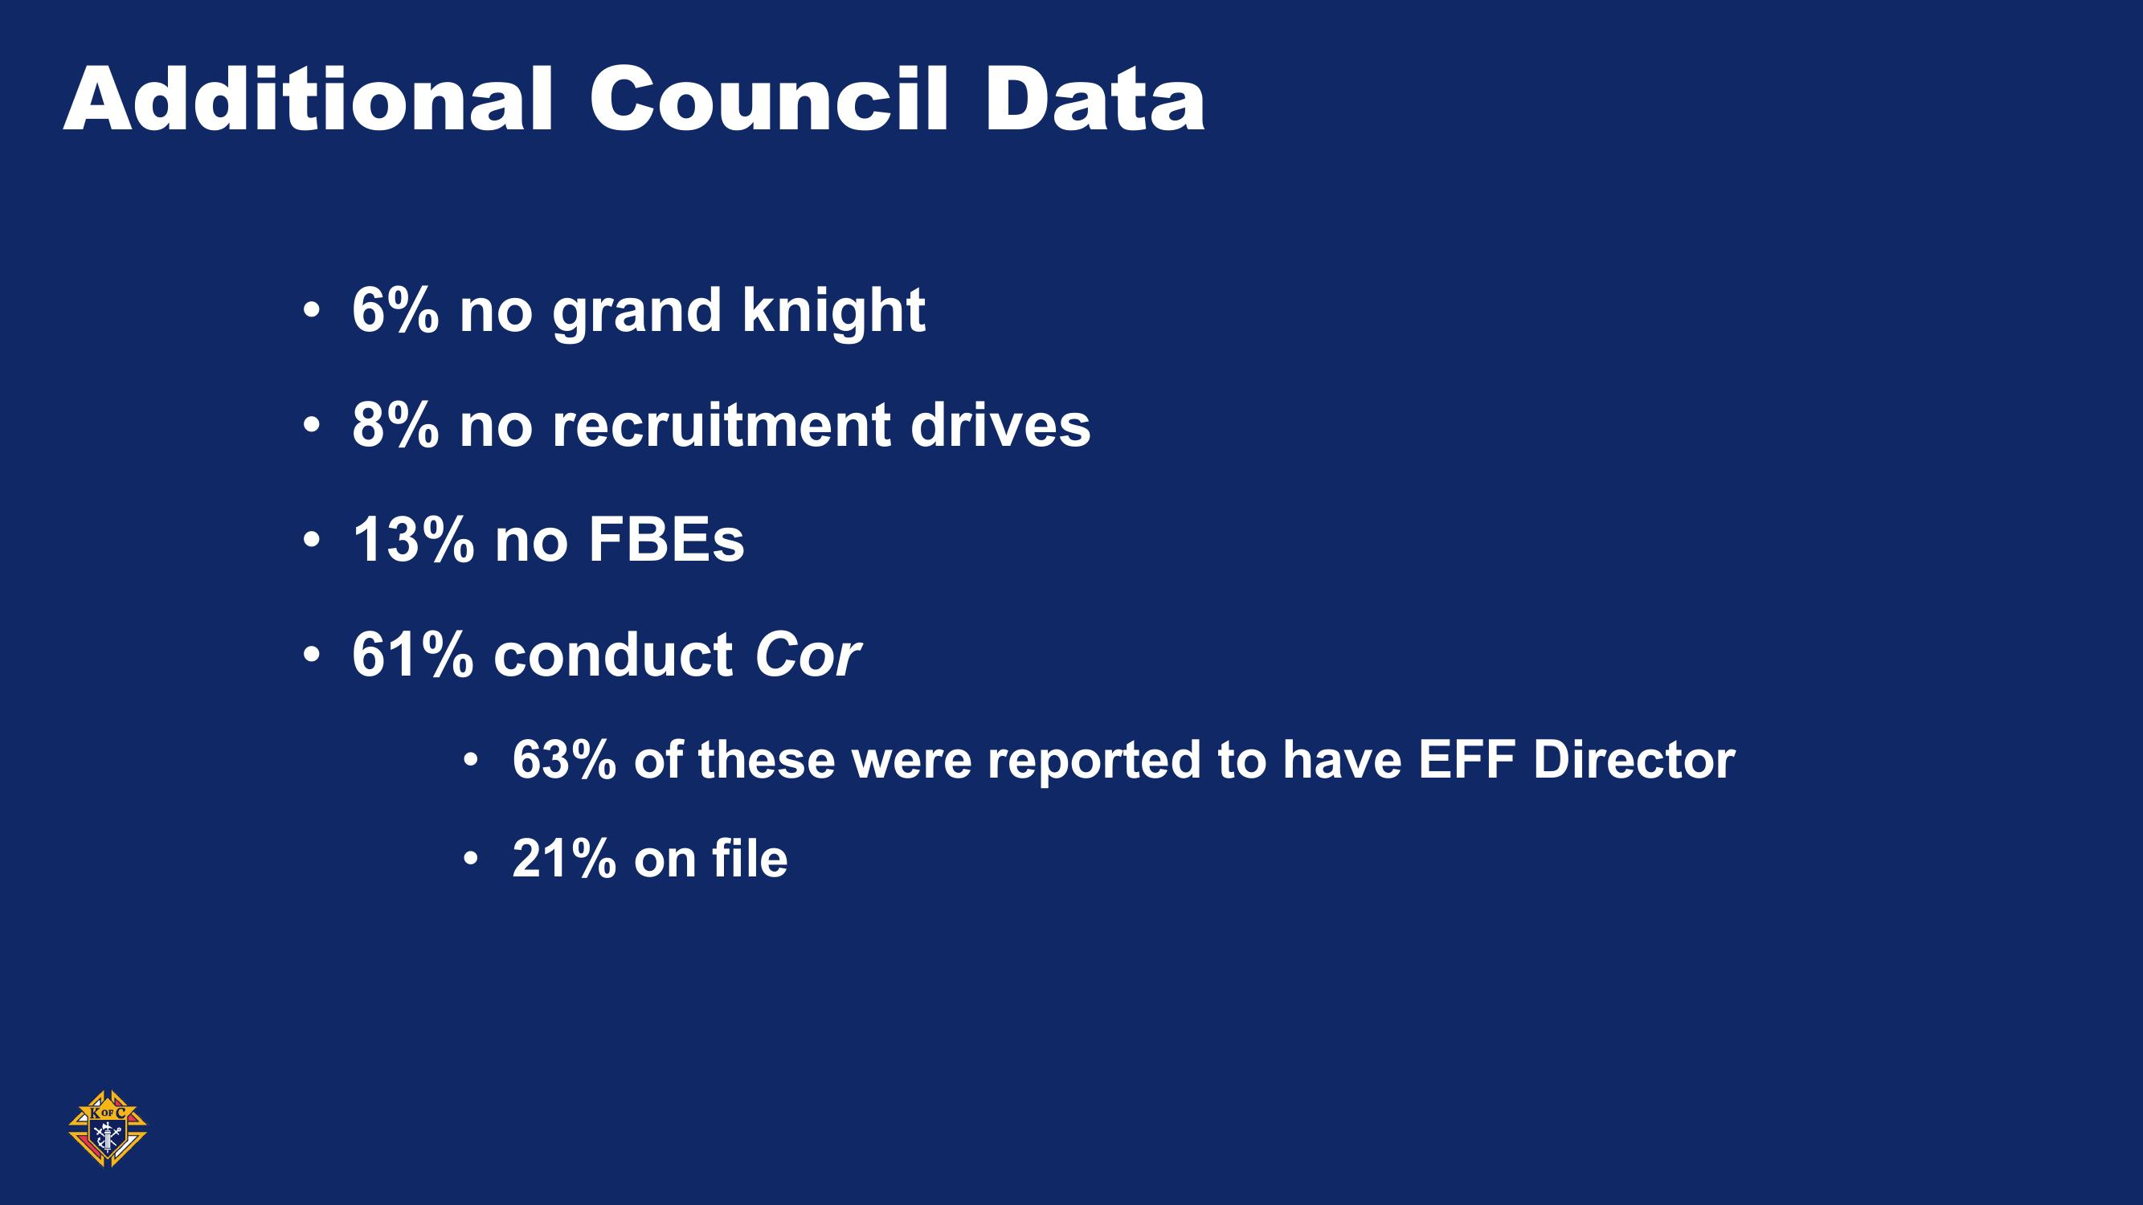
“What’s your Why?”

Slide 15
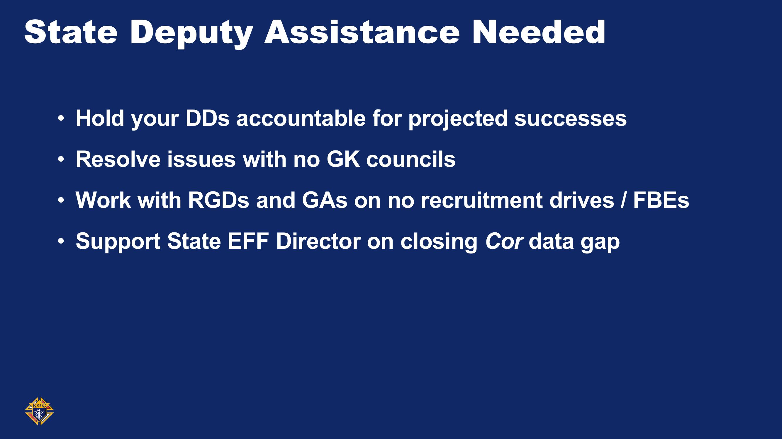
“What’s your Why?”

Slide 16

“What’s your Why?”

Slide 17
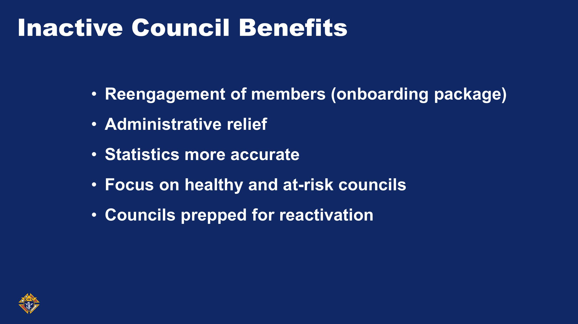
“What’s your Why?”

Slide 18
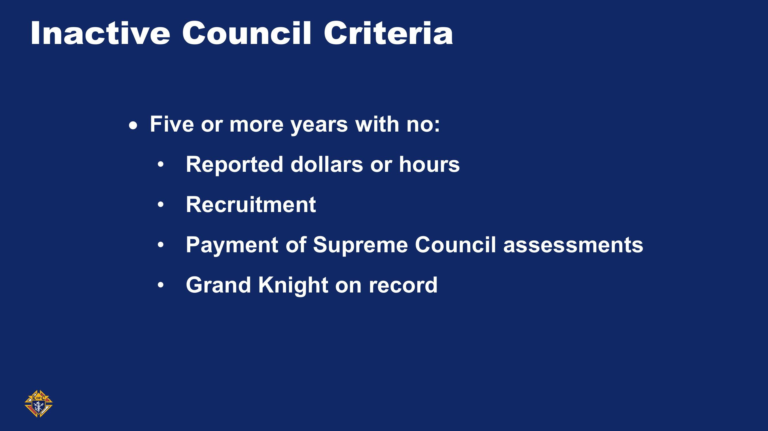
“What’s your Why?”

Slide 19
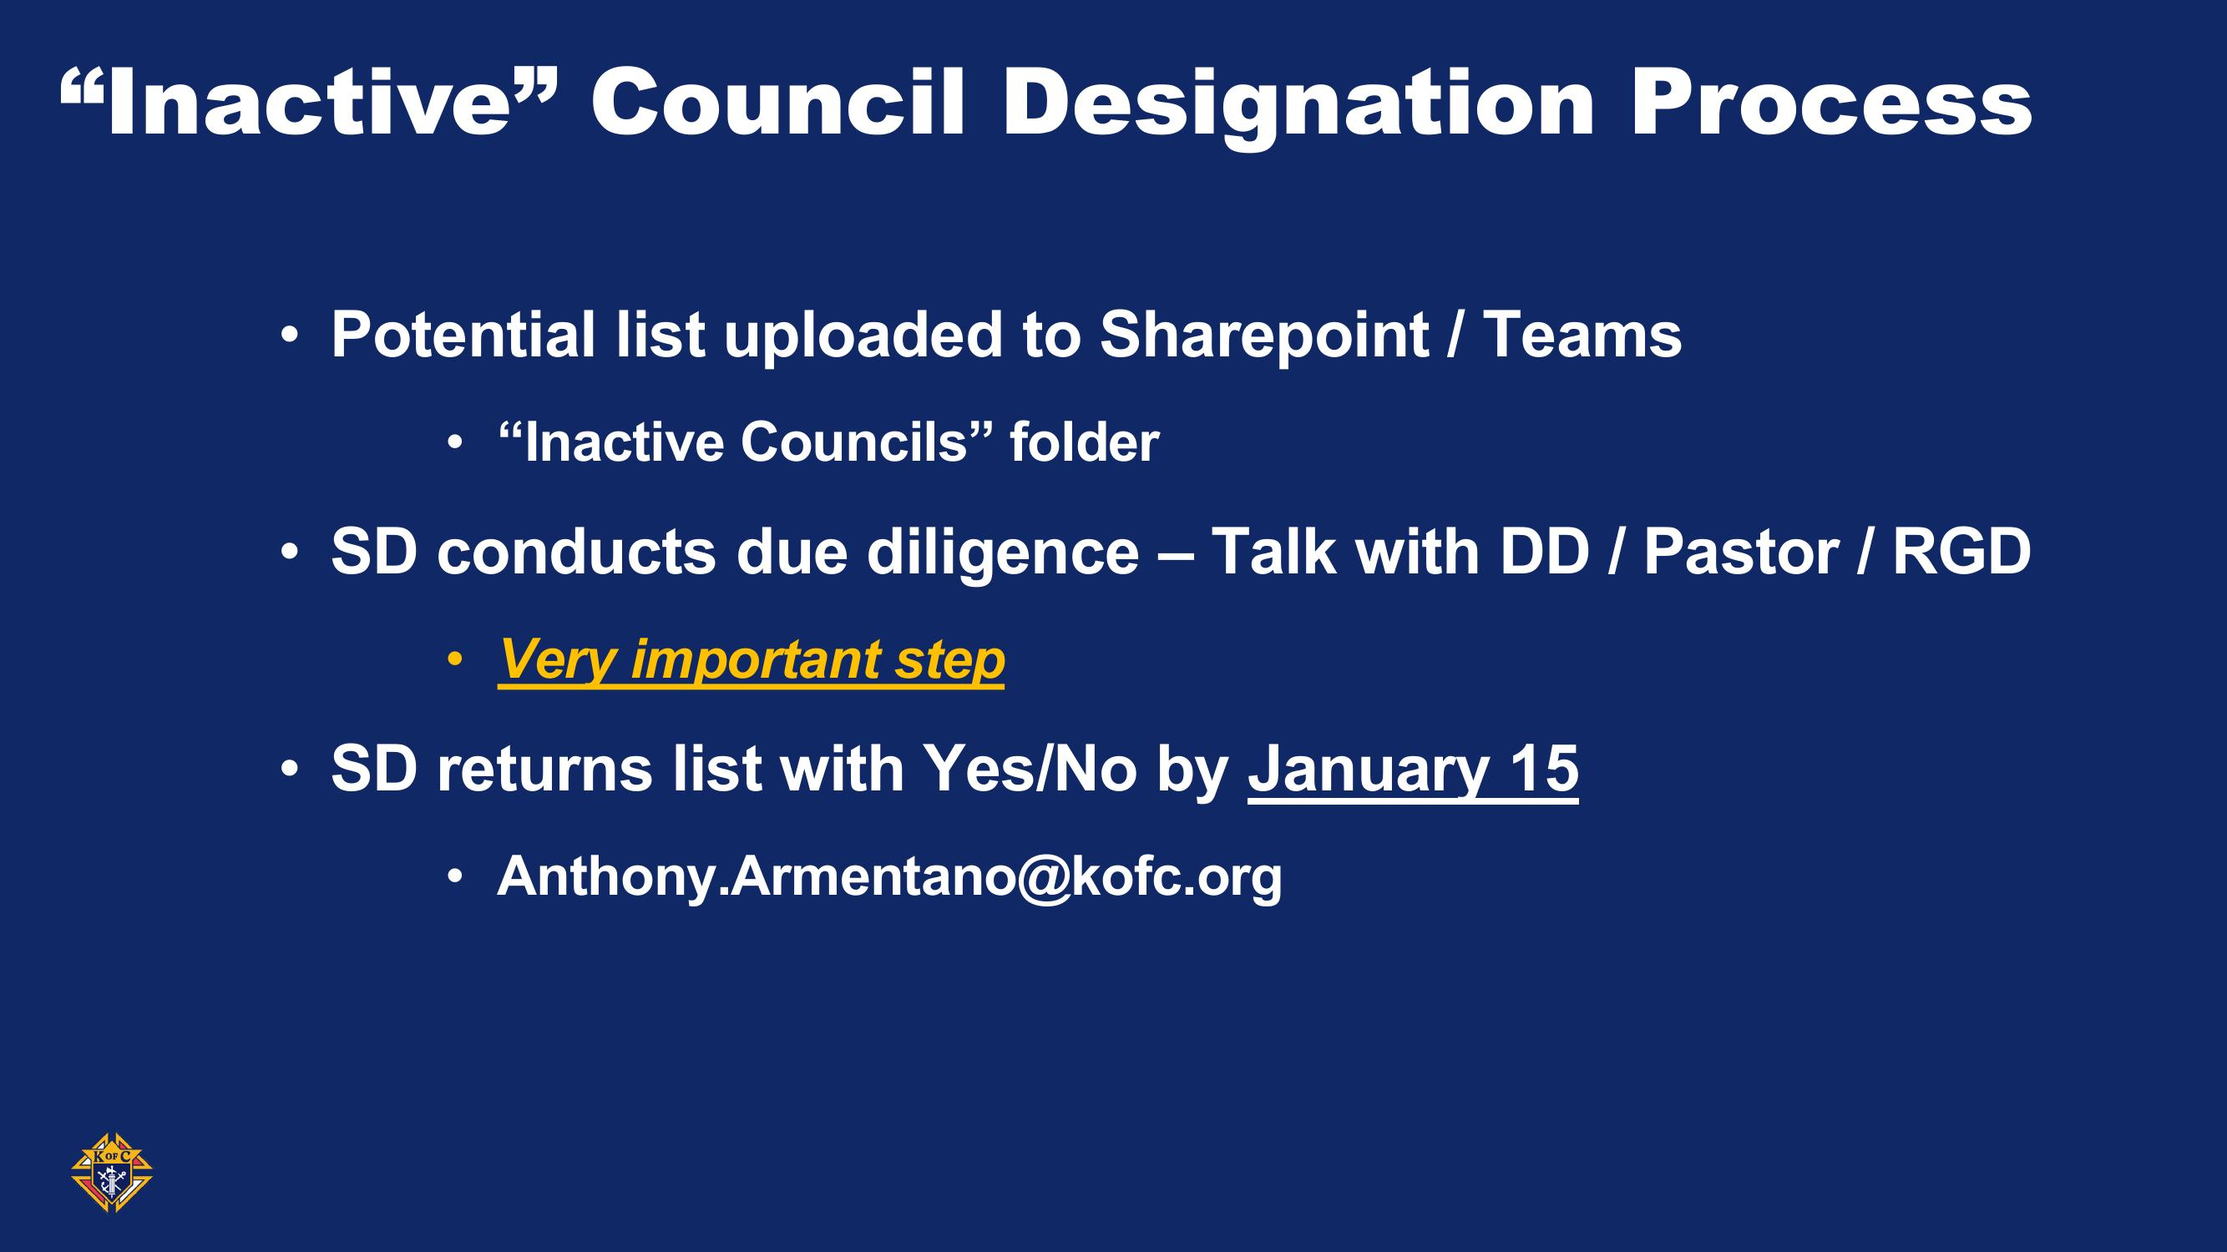
“What’s your Why?”

Slide 20
Council # | Jurisdiction | Region | Council Status | Grand Knight on file? | Last Pay Date | Last Recruitment Date | Total Membership
1391 | Minnesota | US | Suspended | NO | 7/22/2019 | 1/20/2019 | 116
1633 | Minnesota | US | Suspended | NO | 2/24/2020 | 9/20/2018 | 141
2587 | Minnesota | US | Suspended | NO | 2/18/2020 | 4/16/2020 | 107
2769 | Minnesota | US | Suspended | NO | 8/16/2021 | 3/31/2022 | 76
3539 | Minnesota | US | Suspended | NO | 1/11/2022 | 4/3/2018 | 61
4340 | Minnesota | US | Suspended | NO | 1/27/2012 | 4/6/2008 | 77
5365 | Minnesota | US | Suspended | NO | 3/6/1996 | 2/19/1995 | 54
5934 | Minnesota | US | Suspended | NO | 2/5/2020 | 9/21/2017 | 79
6582 | Minnesota | US | Suspended | NO | 8/23/2018 | 4/2/2015 | 38
6773 | Minnesota | US | Suspended | NO | 8/18/2016 | 12/3/2012 | 40
7151 | Minnesota | US | Suspended | NO | 8/21/2007 | 2/22/2006 | 10
9831 | Minnesota | US | Suspended | NO | 1/19/2001 | 11/22/1994 | 22
13324 | Minnesota | US | Suspended | NO | 4/6/2010 | 4/19/2005 | 19
15608 | Minnesota | US | Suspended | NO | 3/22/2019 | 2/6/2019 | 51
16716 | Minnesota | US | Suspended | NO | 4/18/2023 | 3/6/2019 | 39
16852 | Minnesota | US | Suspended | NO | 1/28/2019 | 11/25/2017 | 25
“What’s your Why?”

Slide 21
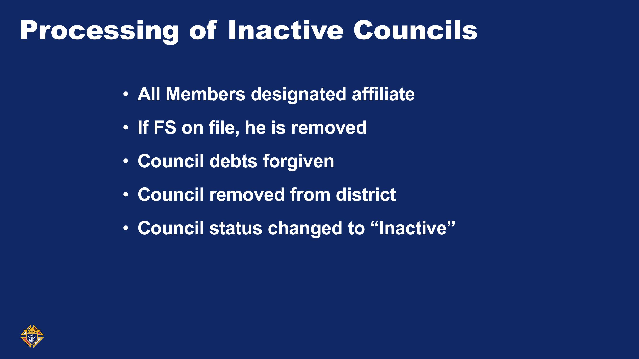
“What’s your Why?”

Slide 22
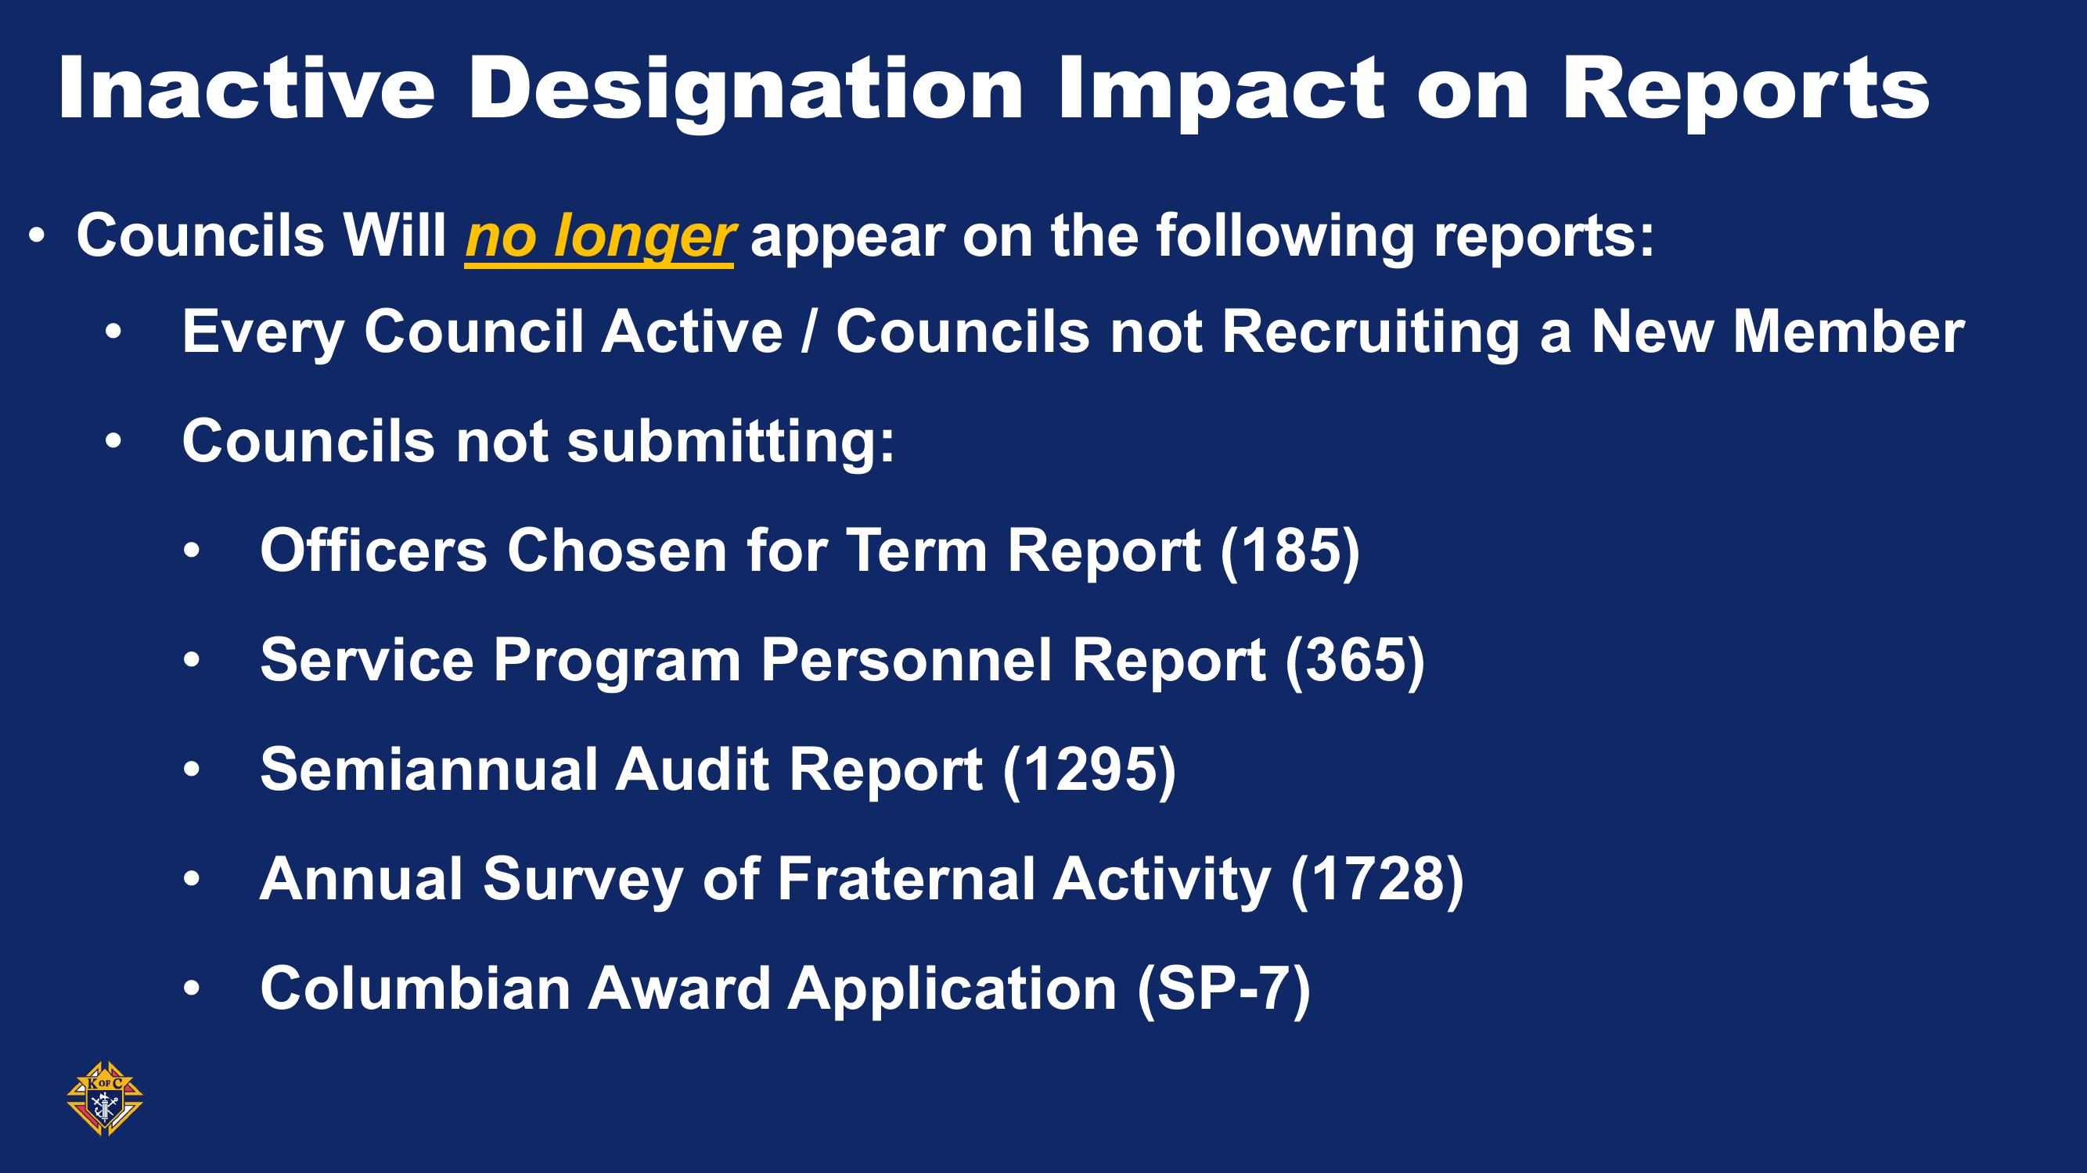
“What’s your Why?”

Slide 23
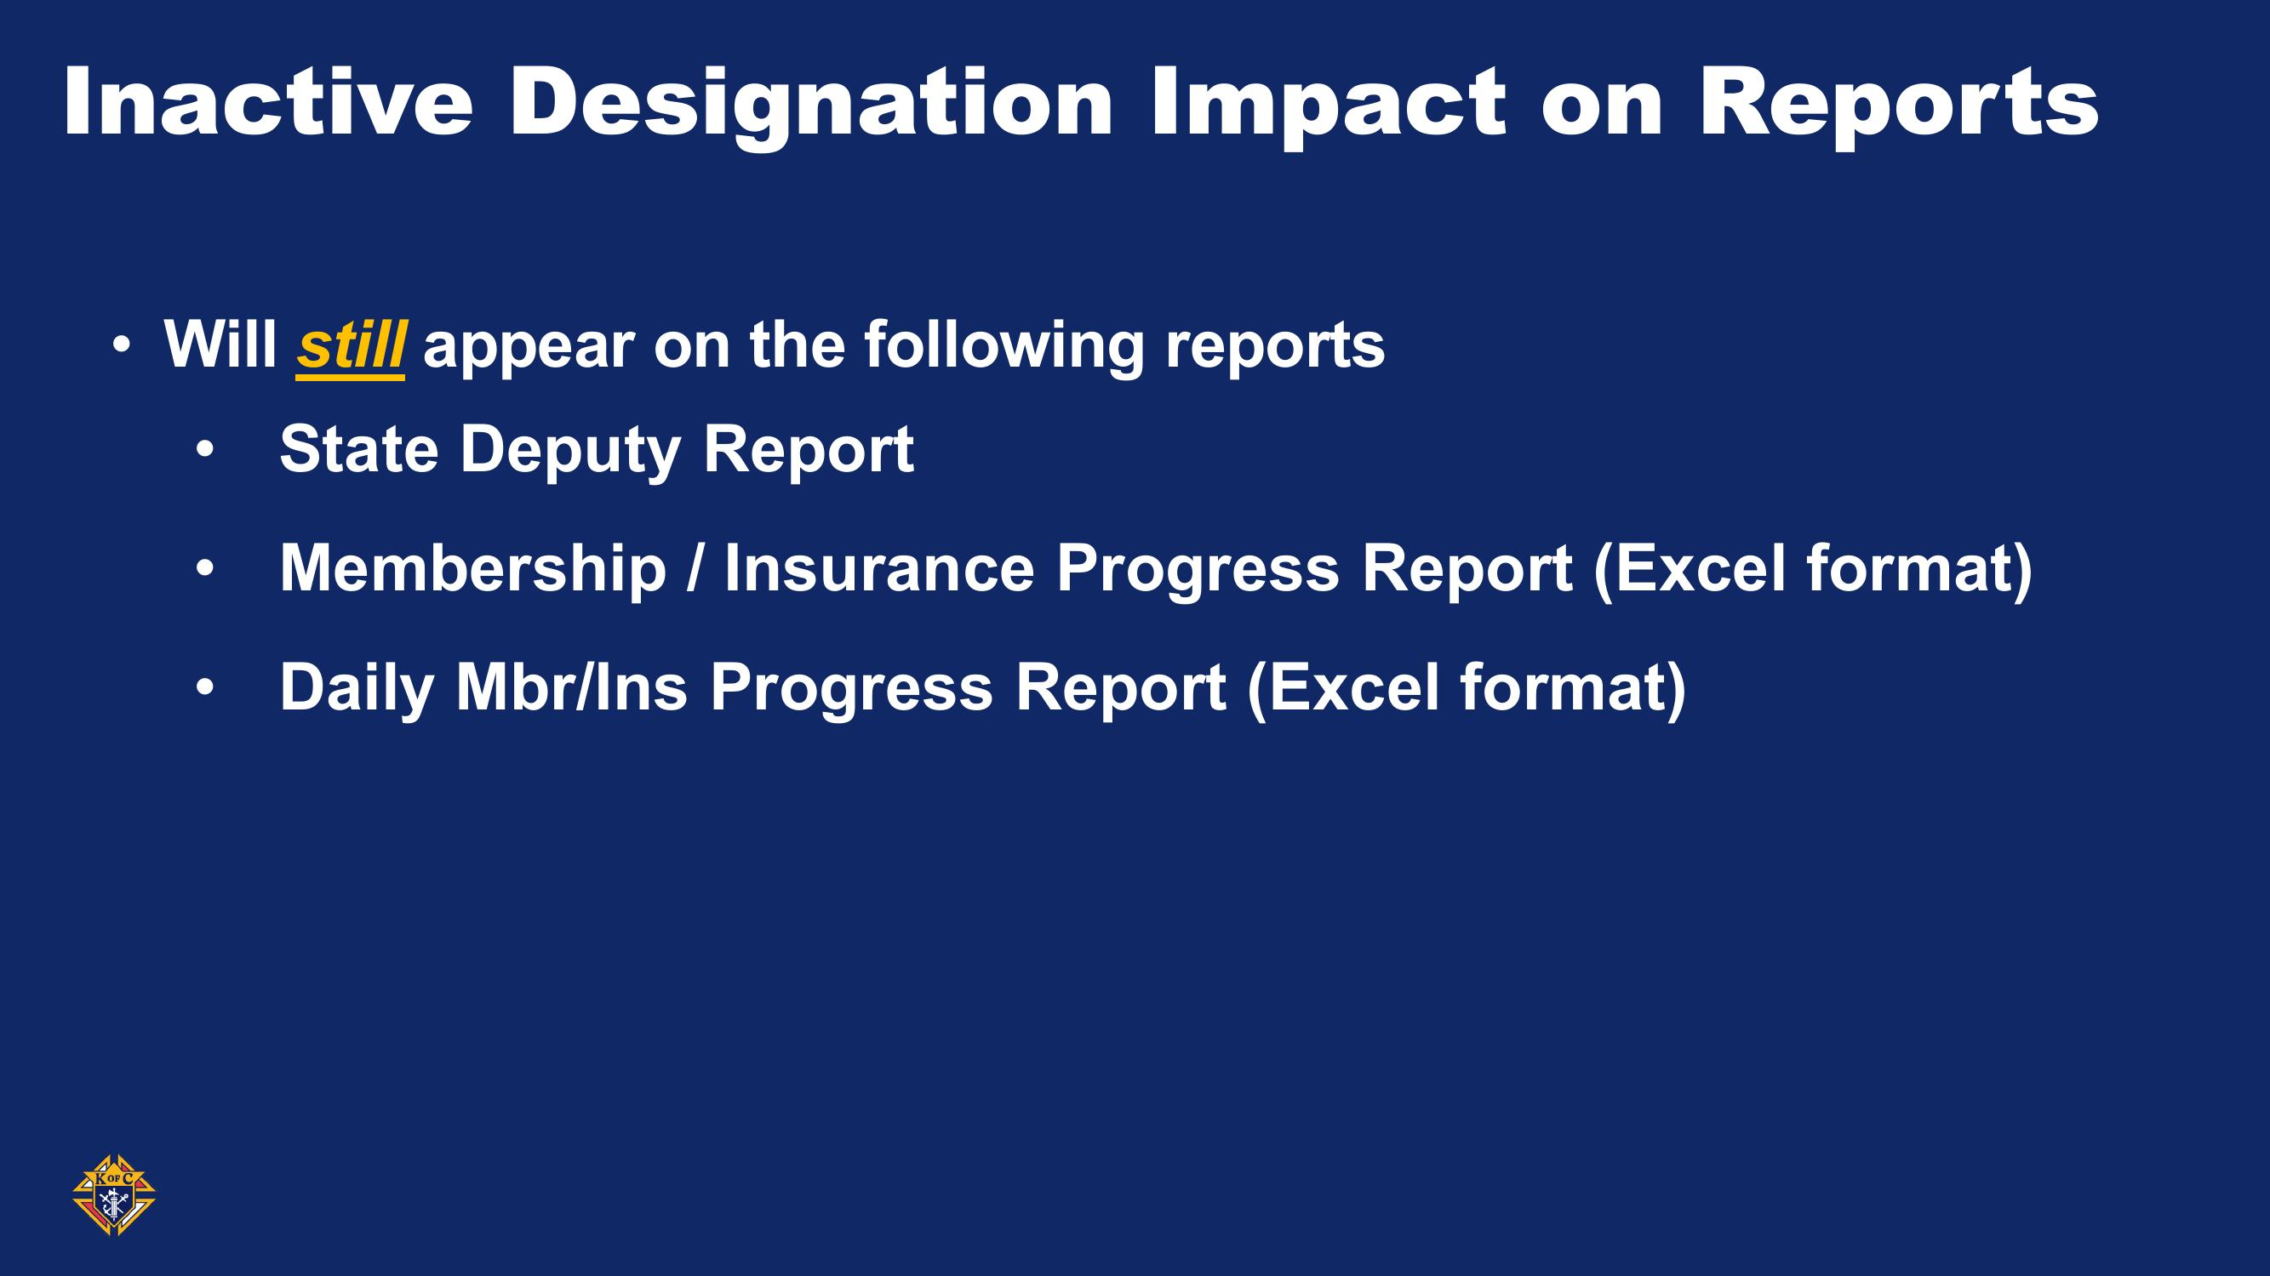
“What’s your Why?”

Slide 24

“What’s your Why?”

Slide 25
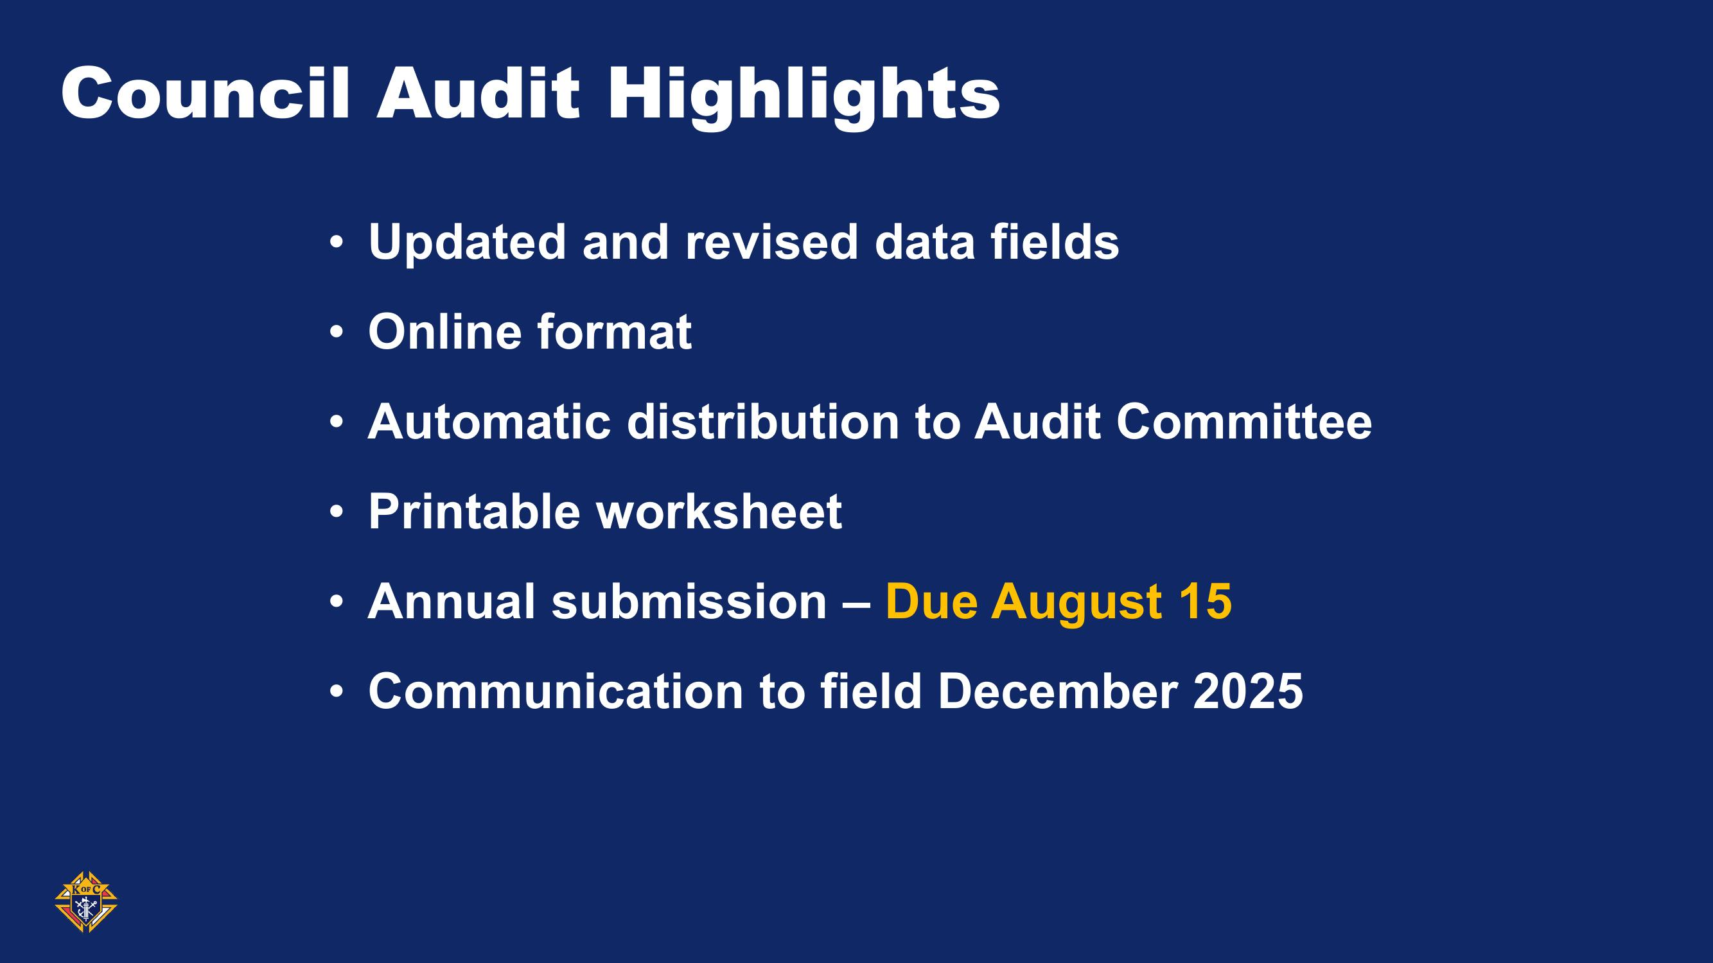
“What’s your Why?”

Slide 26
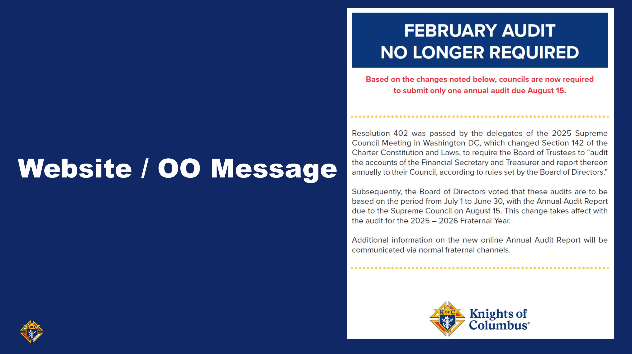
“What’s your Why?”

Slide 27
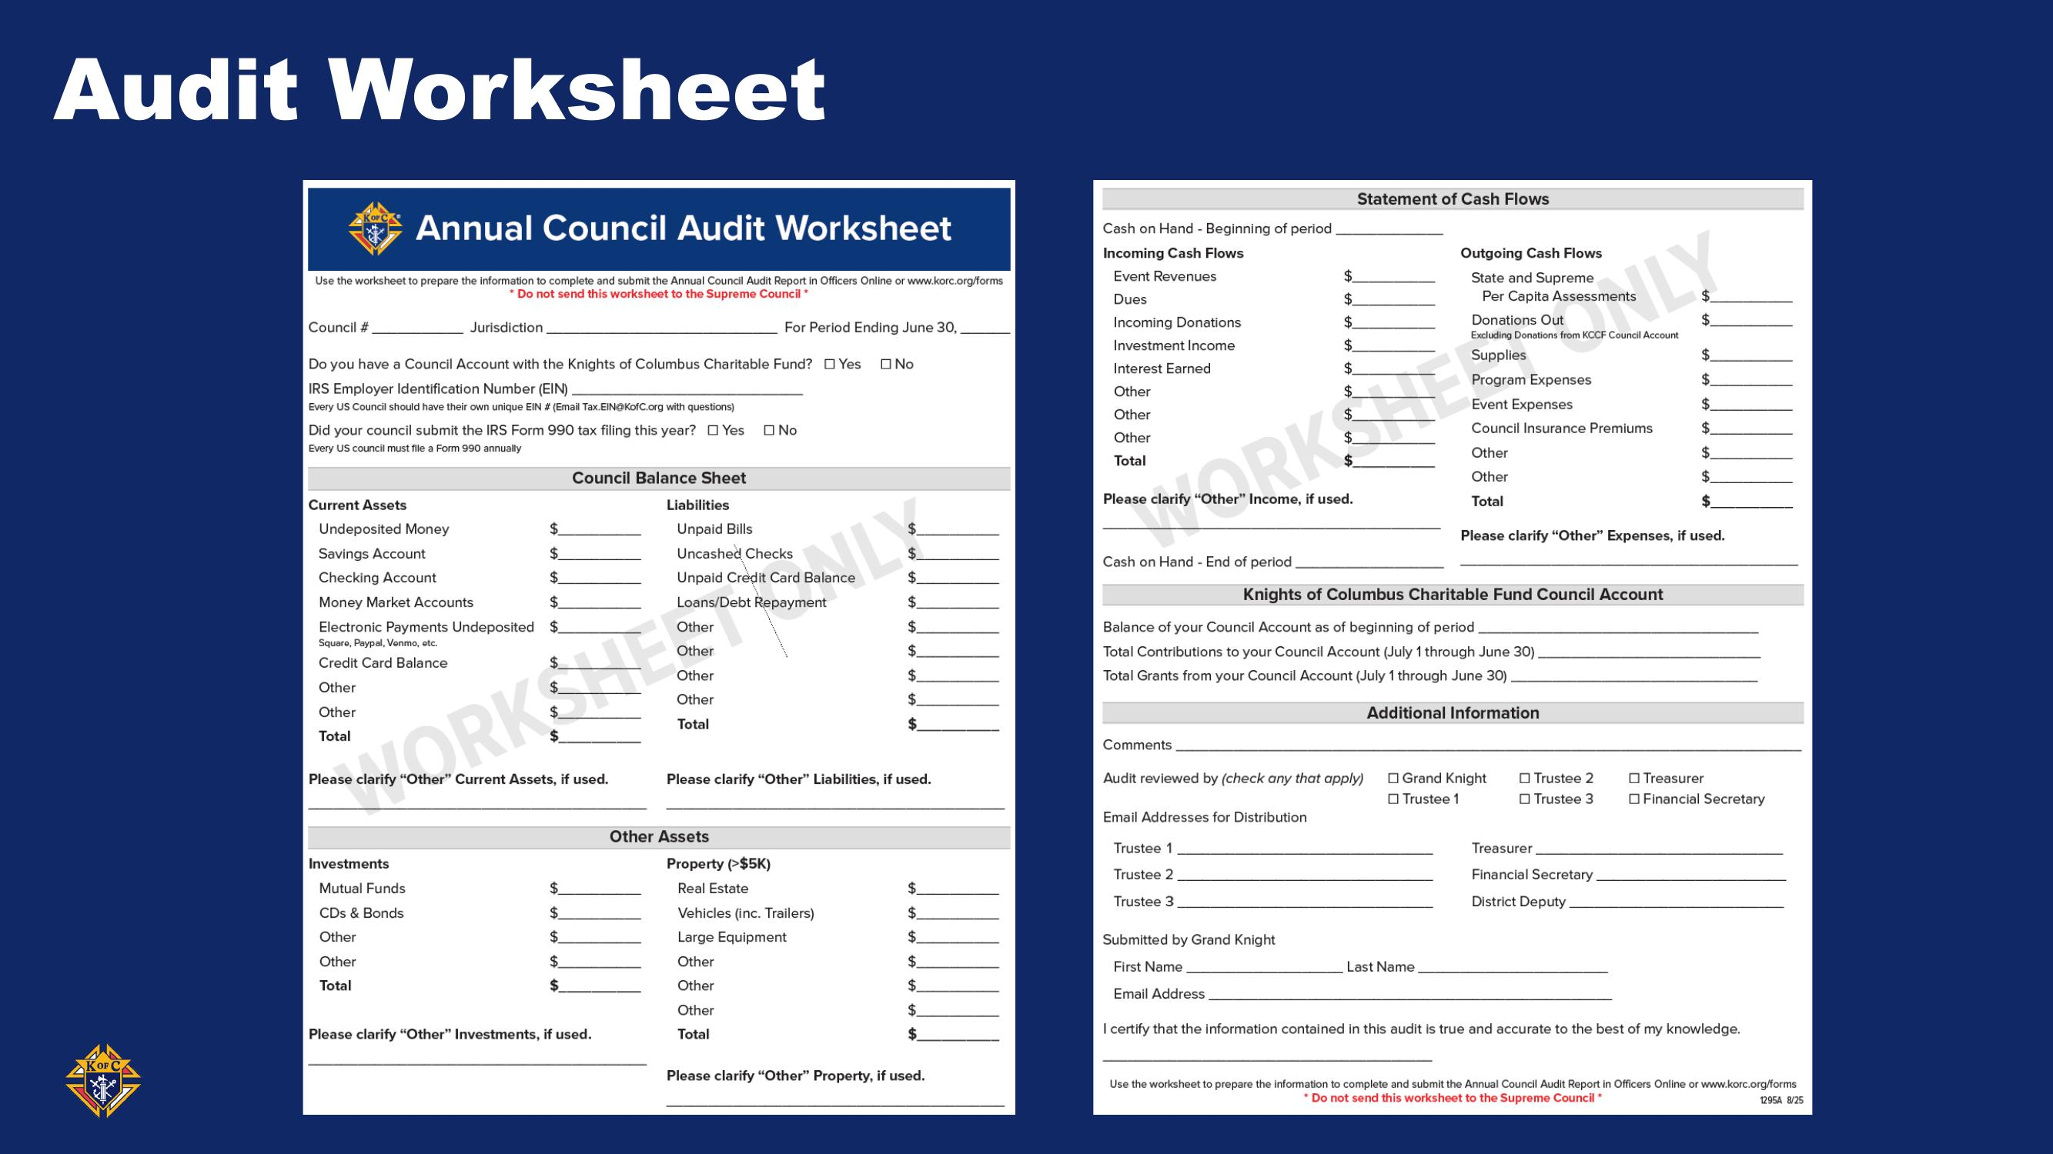
“What’s your Why?”

Slide 28
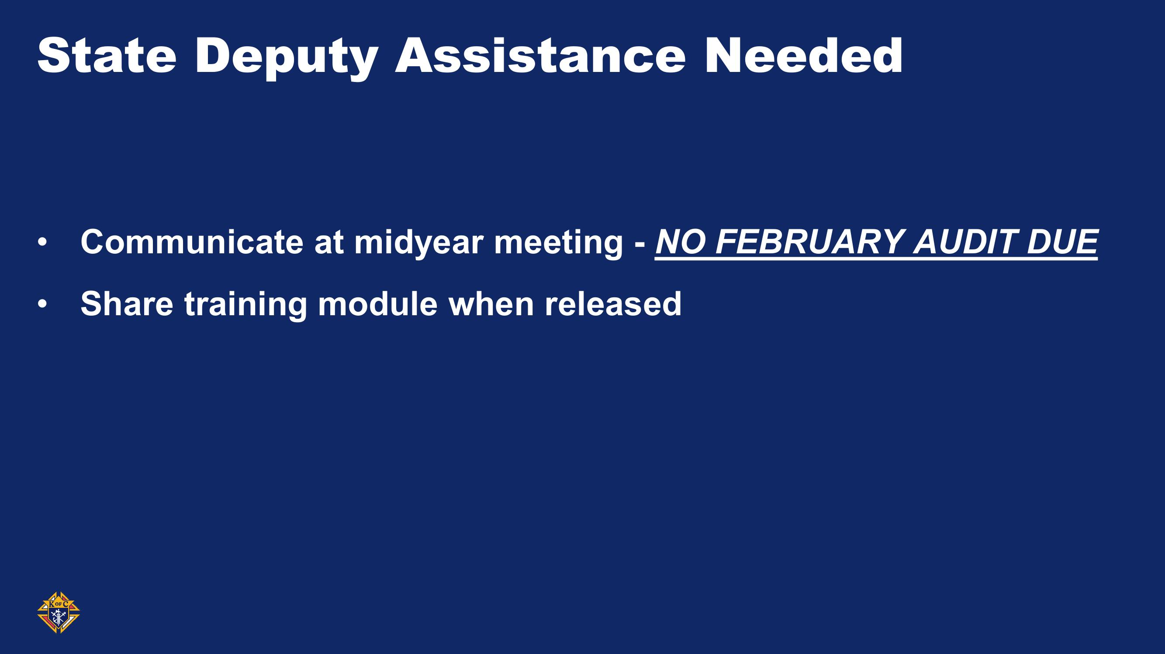
“What’s your Why?”

Slide 29

“What’s your Why?”

Slide 30
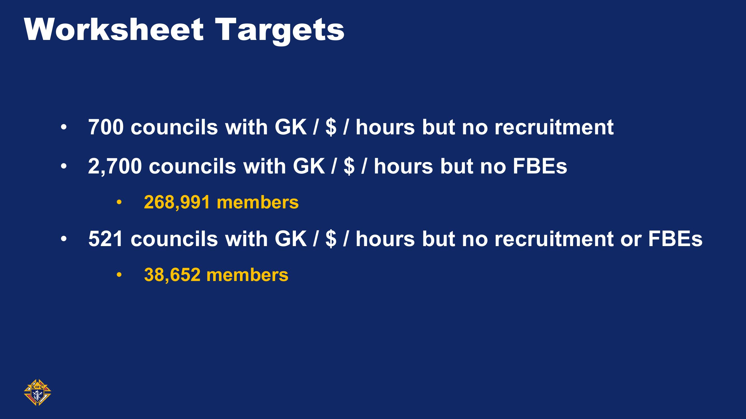
“What’s your Why?”

Slide 31

“What’s your Why?”

Slide 32
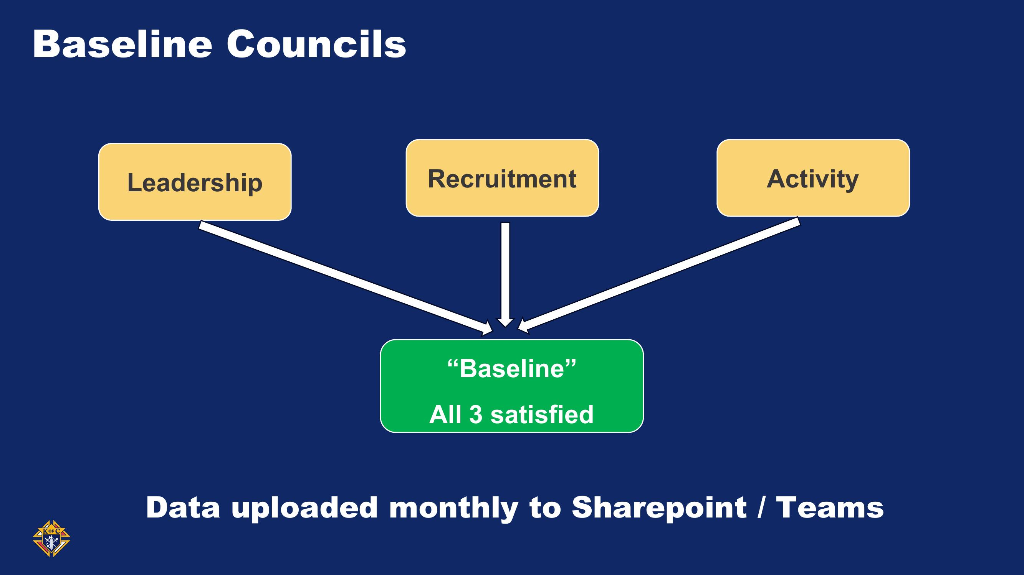
“What’s your Why?”

Slide 33
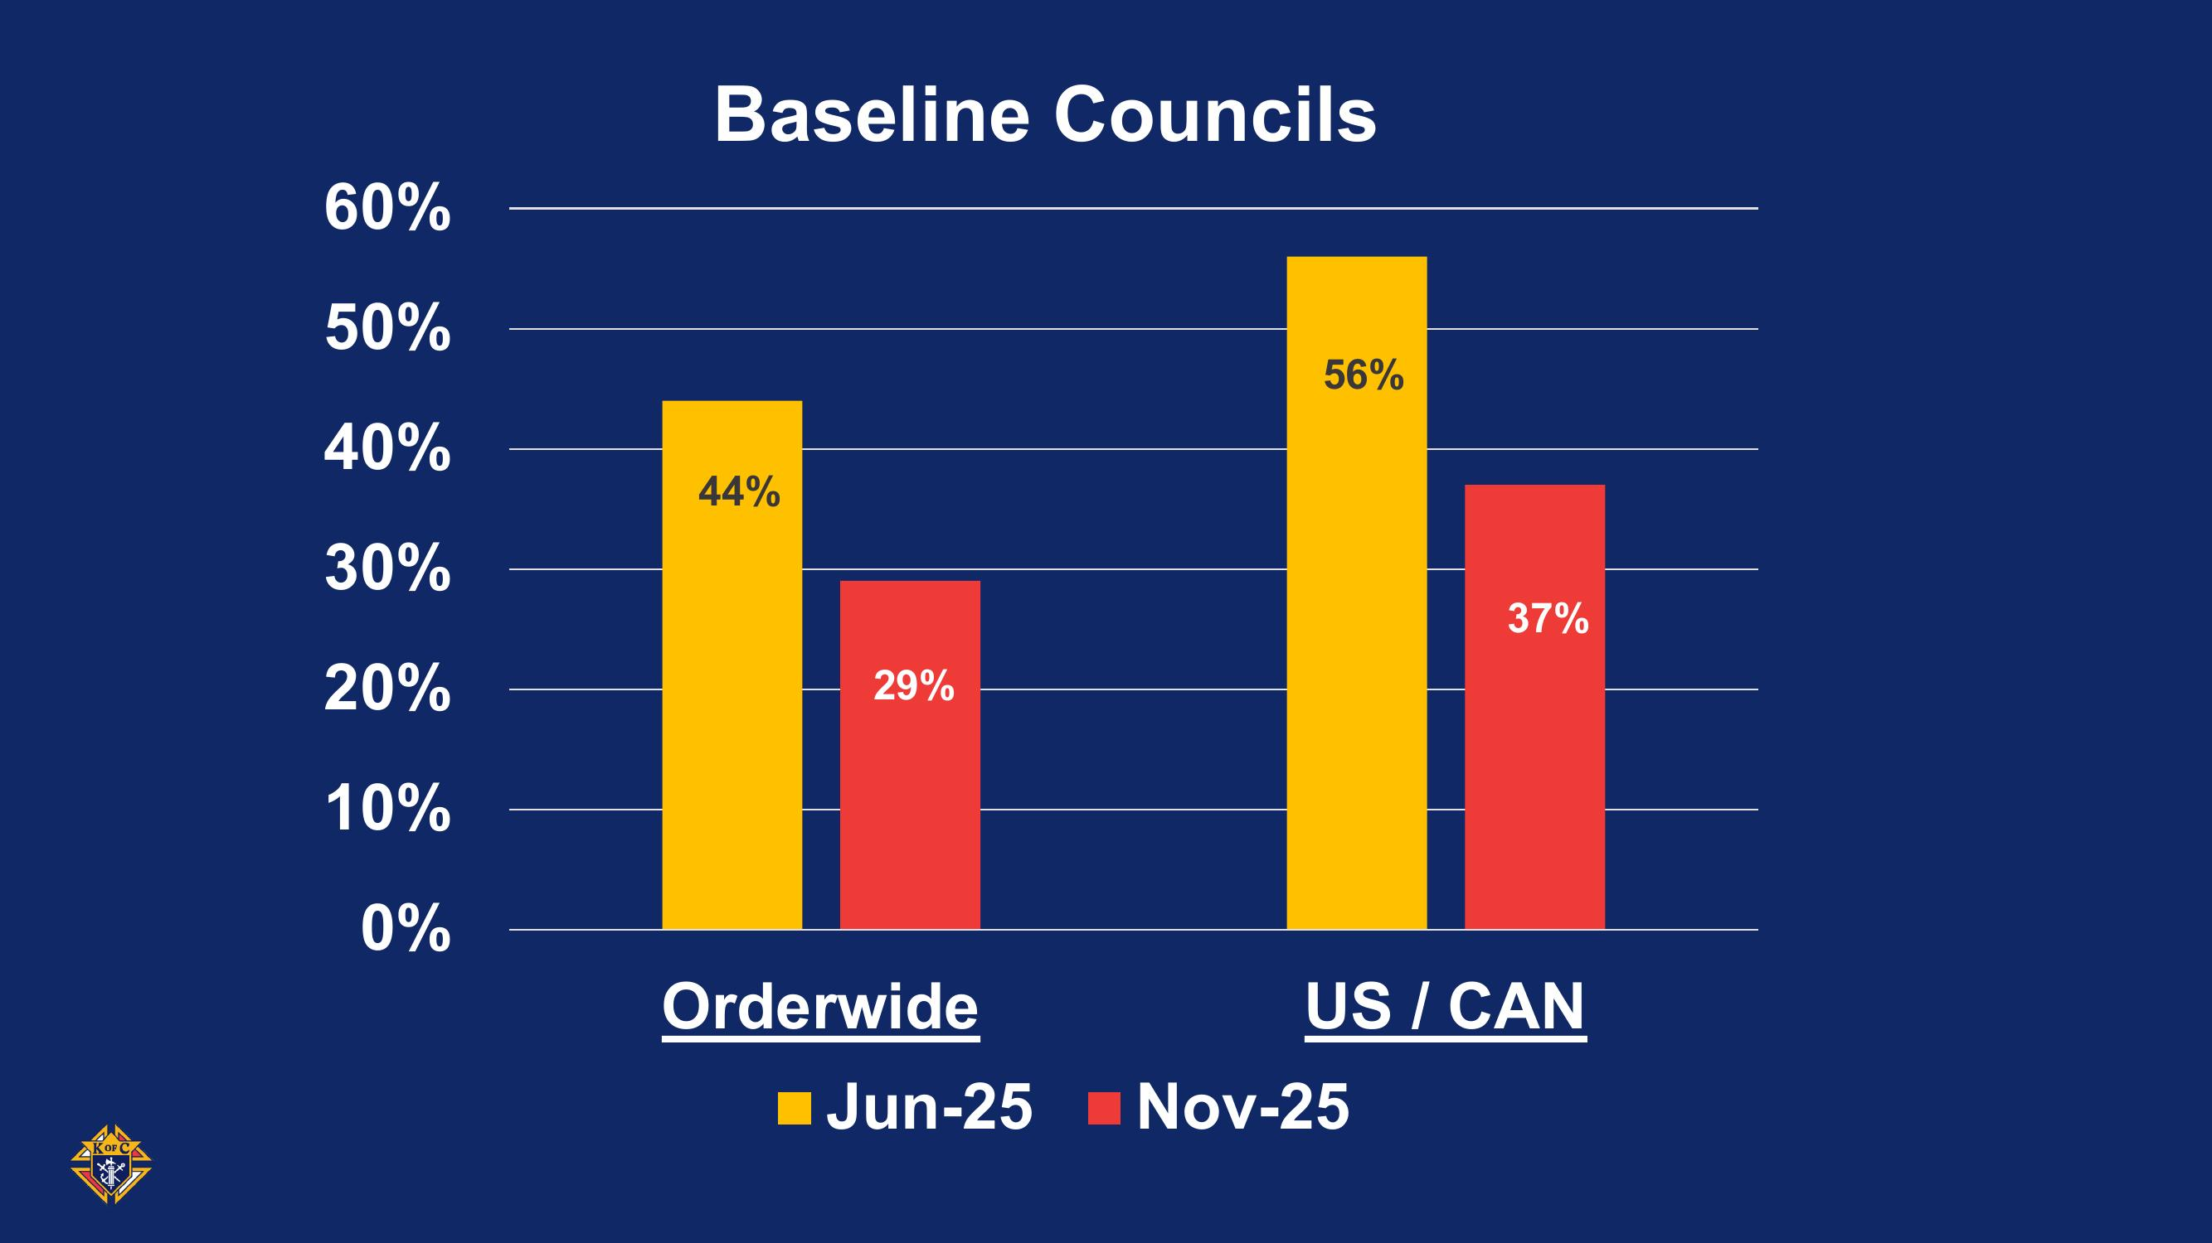
“What’s your Why?”

Slide 34
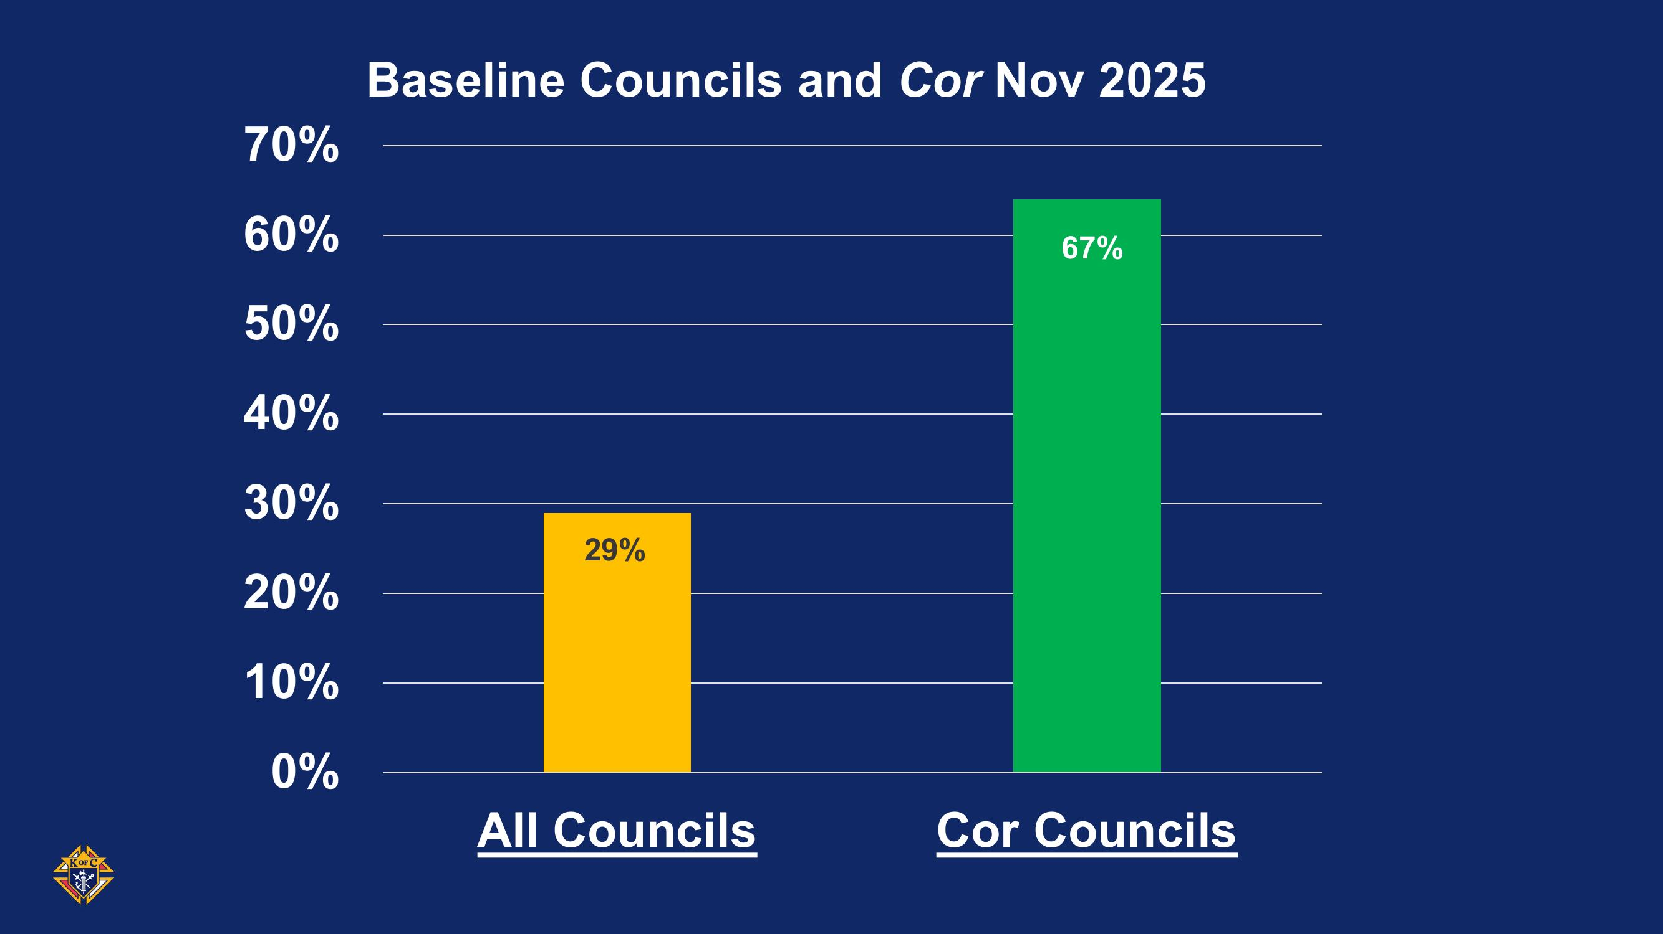
“What’s your Why?”

Slide 35
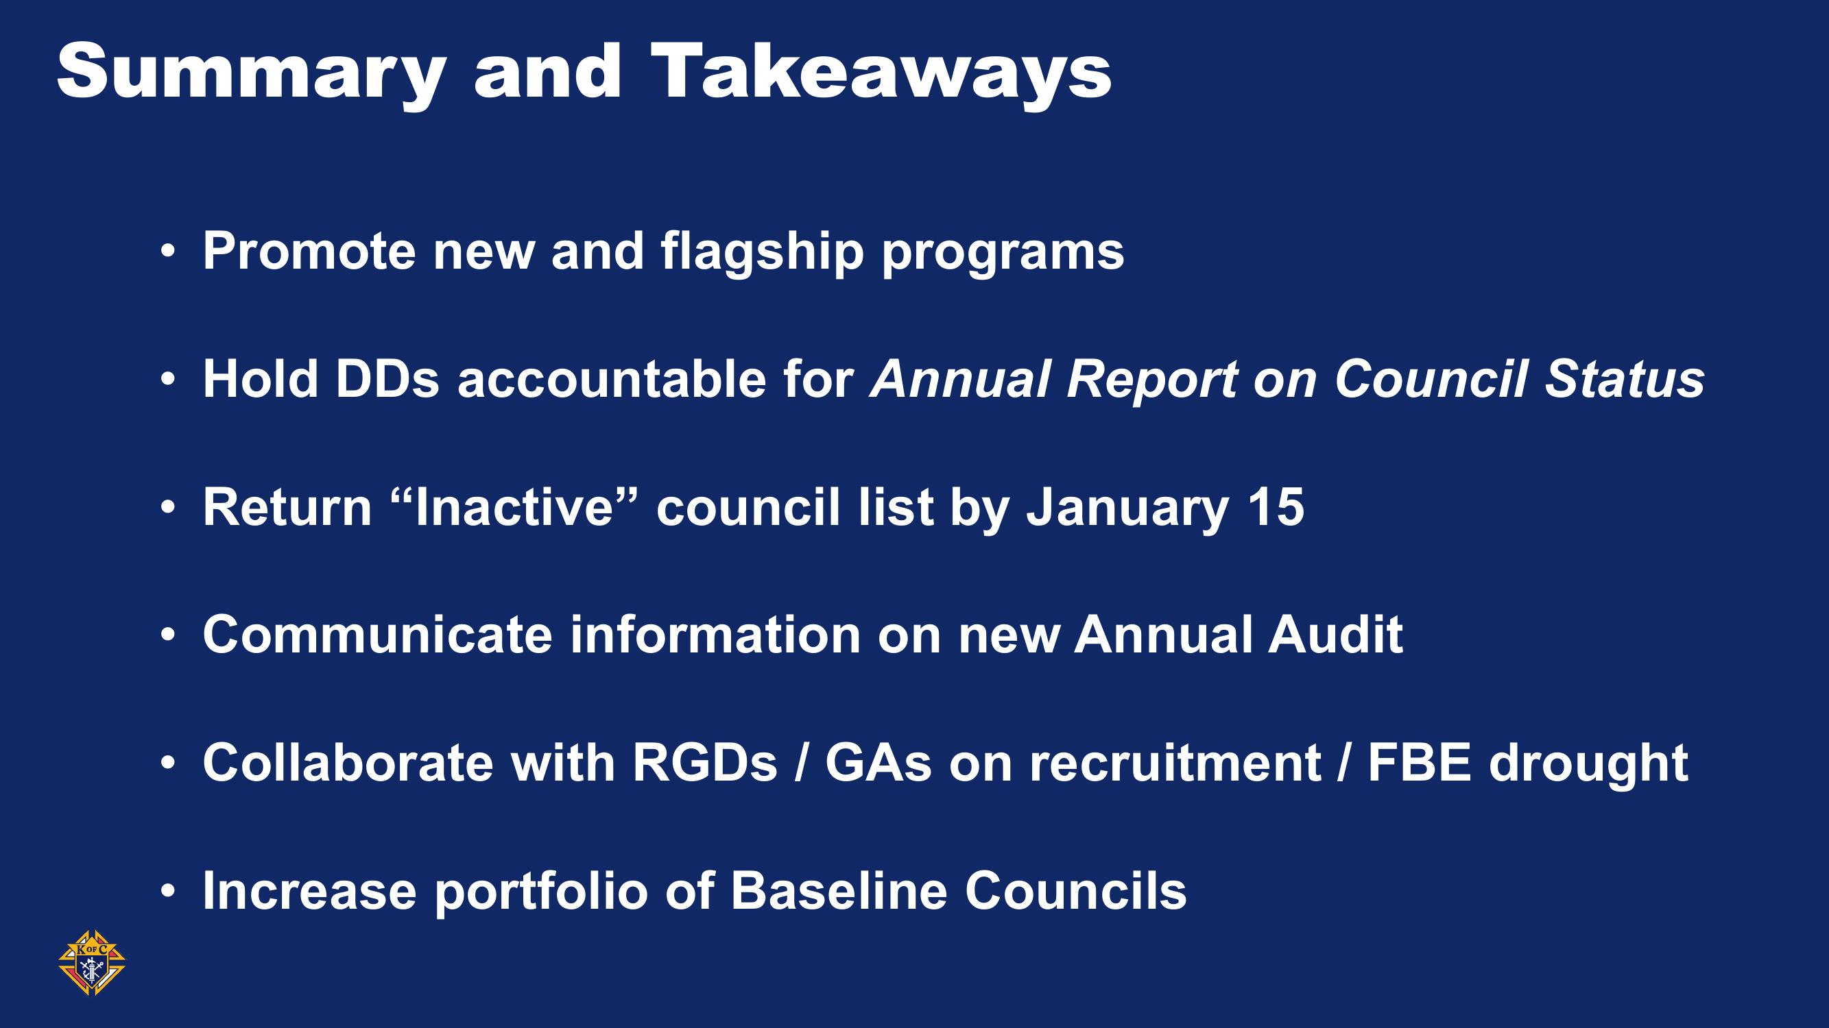
“What’s your Why?”

Slide 36

“What’s your Why?”

